Slide 1
Driver Assistance System
Team Members :
Aravind.P
Nachammai Devi Pooja.S
Prathyush.S
Praveen Kumar. V
Under the Guidance of : Mrs. Angel Deborah (AP) , Mr.Sarath Chandran (AP) Department of Computer Science and Engineering, SSN college of Engineering, Kalavakkam , Chennai.

Slide 2
Objective:
To detect the driver fatigue using a rugged mechanism analysing the human eye continuously using image processing tools.
To interface the software module with the hardware components involving the Internet of Things
To produce mechanical vibrations to manually wake or alarm the driver instantly
To detect alcohol consumption using alcohol content detection module.
To alert the other passengers through SMS and internet call.

Slide 3
Problem definition:
This project is based on the design and development of a Driver assistance system using signal processing and embedded tools.
The three fundamental modules of this prototype is:
Driver drowsiness detection mechanism
Alcohol content detection module
Vehicle crash detection mechanism
These mechanisms involve interrelated software and hardware sections.

Slide 4
Need of such a system:
The main reason behind accidents is due to the lack of proper sleep and alcohol consumption of the driver.
Generally when a accident takes place, the information is not conveyed to the related persons faster.
This is a promising system expected to aid in the rescuing process by reporting to the concerned person in a matter of seconds the location of the accident, thus lowering death's rates.

Slide 5
Innovation:
This system conveys a smart and reliable IoT system solution which instantly notifies the whenever an accident takes place and pinpoints its geographic coordinates on the map.
When an accident takes place, a piezoelectric sensor detects it. Then, an algorithm is applied to process the sensor signal and sends appropriate location.

Slide 6
Overall process:

Slide 7
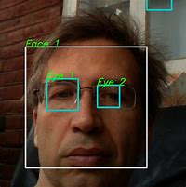
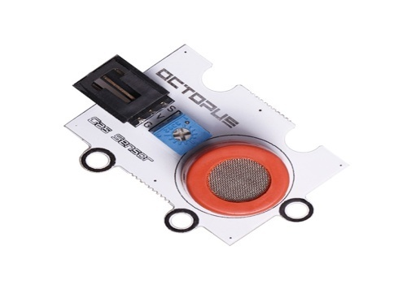
Methodology
Module 1: Eyes Localization Image Processing Eye closure evaluation Alerting
Module 2: Detection of Ethanol Adsorption in MQ3 sensor Alerting phase
Module 3: Detection of vibrations Piezoelectric effect Alerting phase

Slide 8
Project Timeline
Design of circuits | 1 month
Purchase and completion of coding | 2 months
Implementation and integration | 2 months
Interface and final testing | 1 month

Slide 9
Budget : ₹ 17000/-
Raspberry pi3 | 4,185
SIM 900C microcontroller | 1,107
MQ3 gas sensor | 300
Step down transformer(240v -12v) | 700
USB Webcam | 1000
Piezoelectric sensors | 350
buzzer | 200
Power supply unit | 400
12v DC motor | 300
Base chasis | 30
Male to male wire | 100
Female to male wire | 100
Female to female wire | 100
Shock creating circuit | 2500

Slide 10
References
[1] B. Mandal, L. Li, G. S. Wang and J. Lin, "Towards Detection of Bus Driver Fatigue Based on Robust Visual Analysis of Eye State," in IEEE Transactions on Intelligent Transportation Systems, vol. 18, no. 3, pp. 545-557, March 2017.
[2] J. May, C. Baldwin, "Driver fatigue: The importance of identifying causal factors of fatigue when considering detection and countermeasure technologies", Transp. Res. F Traffic Psychol. Behav., vol. 12, no. 3, pp. 218-224, 2009.
[3] A. Sahayadhas, K. Sundaraj, M. Murugappan, "Detecting driver drowsiness based on sensors: A review", Sensors, vol. 12, pp. 16 937-16 953, 2012.
[4] S. Hu, G. Zheng, "Driver drowsiness detection with eyelid related parameters by support vector machine", Exp. Syst. Appl., vol. 36, pp. 7651-7658, 2009.
[5] Q. Ji, X. Yang, "Real-time eye gaze and face pose tracking for monitoring driver vigilance", Real-Time Imaging, vol. 8, no. 5, pp. 357-377, 2002.

